Slide 1



Role of AI in CT imaging for early detection of stroke using HU values
Biomedical image processing
PRESENTED BY GUIDED BY LATHIKA M V (20ECR088) MS.M.PAVITHRA PP/ECE
KARTHIGA K (20ECR073)
KARTEESWAR K P (20ECR071)
BALAKUMARAN E (19ECR019)
BARATH RAJ S (19ECR020)

Slide 2
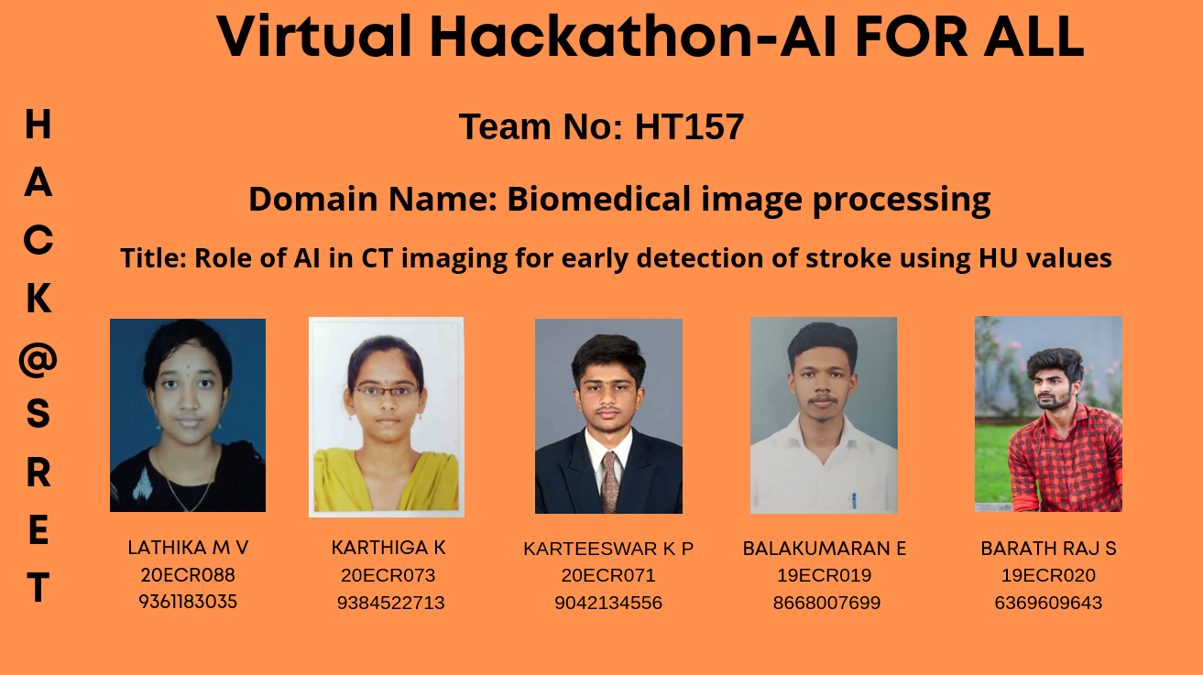

Slide 3
INTRODUCTION
Earlier identification of stroke subtype is very much essential to decide the accurate treatment for patients.
Artificial Intelligence techniques, particularly deep learning techniques plays an important role and produce perfect classification results on a wide variety of data available in the real world.
CT is first and widely used available modality for stroke imaging, but due to high volume of images for a single sample, reporting time and subsequent treatment initiation may be delayed.
Tissues visualized in CT imaging shows a varied degree of gray values, which is measured in terms of Hounsfield Units(HU) values. If the HU value is in the range of 55 to 65, then the presence of hemorrhage is encountered and in ischemic stroke HU value will range from 20 to 30.
Hence, efficient Deep learning(DL) algorithms are developed, which plays a significant role for automatic recognition of subtypes of stroke. So, treatment can be initiated at the earlier stages and hence prognosis will be improved.

Slide 4
PROBLEM STATEMENT
AI with many applications in acute stroke imaging including ischemic and hemorrhagic subtypes, early identification of stroke subtype is important because of treatment is different for two types.
CT is first and widely available modality for stroke imaging.
But due to high volume of images and patient load the reporting can be delayed, subsequent treatment initiation also will be delayed.

Slide 5
SOLUTION
Earlier identification of stroke subtype is very much essential to decide the accurate treatment for patients. Artificial Intelligence techniques, particularly deep learning techniques plays an important role and produce perfect classification results on a wide variety of data available in the real world.
CT is first and widely used available modality for stroke imaging, but due to high volume of images for a single sample, reporting time and subsequent treatment initiation may be delayed.
Tissues visualized in CT imaging shows a varied degree of gray values, which is measured in terms of Hounsfield Units(HU) values. If the HU value is in the range of 55 to 65, then the presence of hemorrhage is encountered and in ischemic stroke HU value will range from 20 to 30.
Hence, efficient Deep learning(DL) algorithms are developed, which plays a significant role for automatic recognition of subtypes of stroke. So, treatment can be initiated at the earlier stages and hence prognosis will be improved.

Slide 6
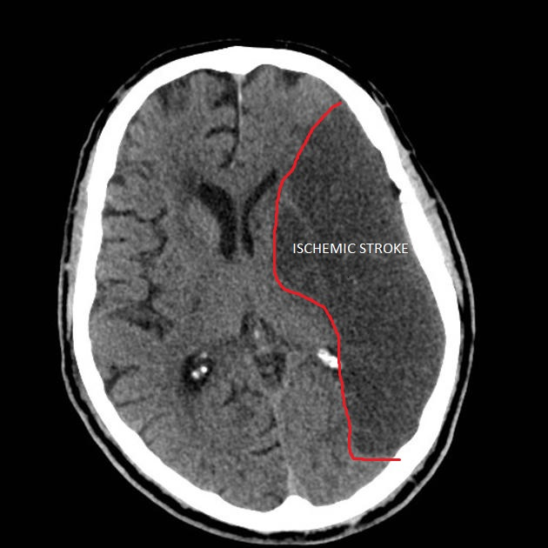
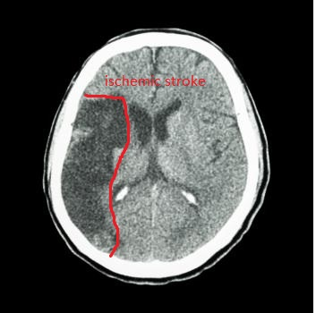
ISCHEMIC STROKE
Blood supply to part of the brain is decreased, leading to disfunction of the brain tissue in that area.

Slide 7
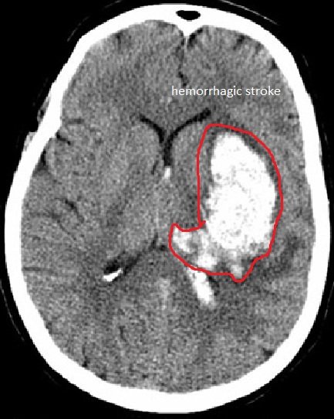
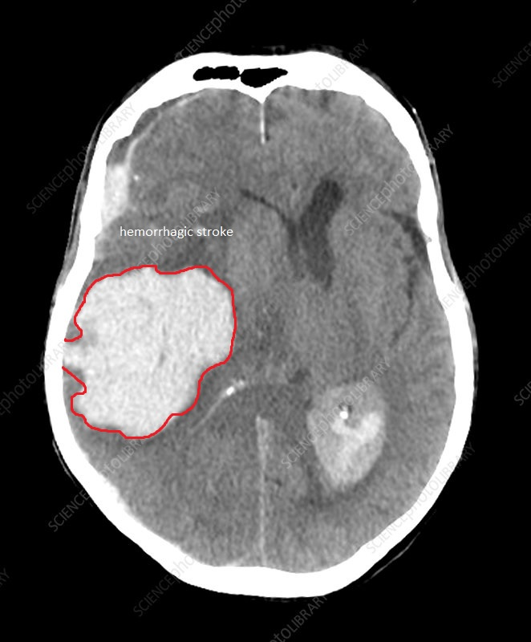
HEMORRHAGIC STROKE
Bleeding within the brain itself.
Types
Intraparenchymal hemorrhage
Intraventricular hemorrhage

Slide 8
OBJECTIVE
The main objective of our work is to design an automatic stroke subtypes identification using an efficient algorthim which is based on deep learning methods.Earlier detection of stroke subtypes will help medical practitioners to provide appropriate treatments at the right time.

Slide 9
TOOLS USED
Open CV in visual studio 2019 .
python in anaconda.
LabVIEW.
Matlab.

Slide 10
CONCLUSIONS
This research work will greatly help the medical practitioners for easy diagnosis and treatment of stroke subtypes which inturn will reduce the man power requirement for analysis of CT images of brain.

Slide 11
REFERENCES
Mozaffarian D, Roger VL, et al. Heart disease and stroke statistics—2013 update a report from the American Heart Association. Circulation. 2013;127:E6–245.
Benjamin EJ, Muntner P, Alonso A, et al. Heart disease and stroke statistics—2019 update: A report from the American Heart Association. Circulation. 2019.
Benjamin EJ, Blaha MJ, Chiuve SE, et al. Heart disease and stroke statisticsl2017 update: A report from the AmericanHeartAssociation.Circulation. 2017;135:e146–603.
Shafaat O, Sotoudeh H. Stroke imaging. [Updated 2020 Jul 4]. In: StatPearls [Internet]. Treasure Island (FL): StatPearls Publishing; 2021. Jan.
Musuka TD, Wilton SB, Traboulsi M, Hill MD. Diagnosis and management of acute ischemic stroke: Speed is critical. CMAJ. 2015;187:887–893.
Attyé A, Ognard J, Rousseau F, Ben Salem D. Artificial neuroradiology: Between human and artificial networks of neurons? J Neuroradiol. 2019;46:279–280.
Lee EJ, Kim YH, Kim N, Kang DW. Deep into the brain: Artificial intelligence in stroke imaging. J Stroke. 2017;

Slide 12
Sotoudeh H, Shafaat O, Sotoudeh E. Misleading CT perfusion in subacute ischemic stroke. Emerg Radiol. 2019;26(5):581–586.
Soun JE, Chow DS, Nagamine M, et al. Artificial intelligence and acute stroke imaging. Am J Neuroradiol. 2021;42:2–11.
Albers GW, Wald MJ, Mlynash M, et al. Automated calculation of Alberta stroke program early CT score: Validation in patients with large hemispheric infarct. Stroke. 2019;50:3277–3279.
Yedavalli VS, Tong E, Martin D, Yeom KW, Forkert ND. Artificial intelligence in stroke imaging: Current and future perspectives. Clin Imaging. 2021;69:246–254.
Mokin M, Primiani CT, Siddiqui AH, Turk AS. ASPECTS (Alberta Stroke Program Early CT Score) measurement using hounsfield unit values when selecting patients for stroke thrombectomy. Stroke. 2017;48:1574–1579.
Nagel S, Sinha D, Day D, et al. e-ASPECTS software is non-inferior to neuroradiologists in applying the ASPECT score to computed tomography scans of acute ischemic stroke patients. Int J Stroke. 2017;12:615–622.

Slide 13


